Slide 1
Movie ticket booking system
Presented By:
Priyanka Ghimire
Manisha Sharma
Diptan gurung

Slide 2
Introduction
Movie ticket booking system is a system design to simplify the process of reserving movie tickets.
It provides a comprehensive solution for movie enthusiasts to book their tickets with ease.

Slide 3
Problem statement
Complex payment integration
Poor user interface and user experience

Slide 4
Objectives
To improve user experience and accessibility
To make a seamless payment integration

Slide 5
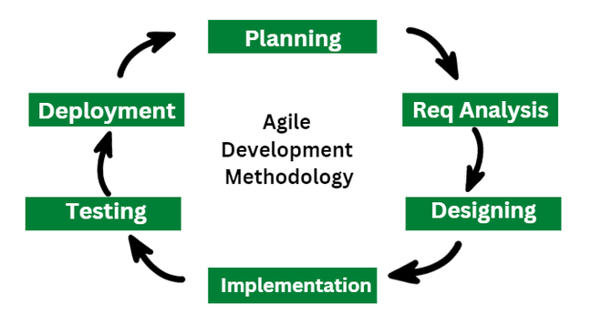
Methodology

Slide 6
Deliverables
User Interface (UI)
Booking Functionality
User Account Management
Database Management
Documentation

Slide 7
Thank you!!

